Slide 1
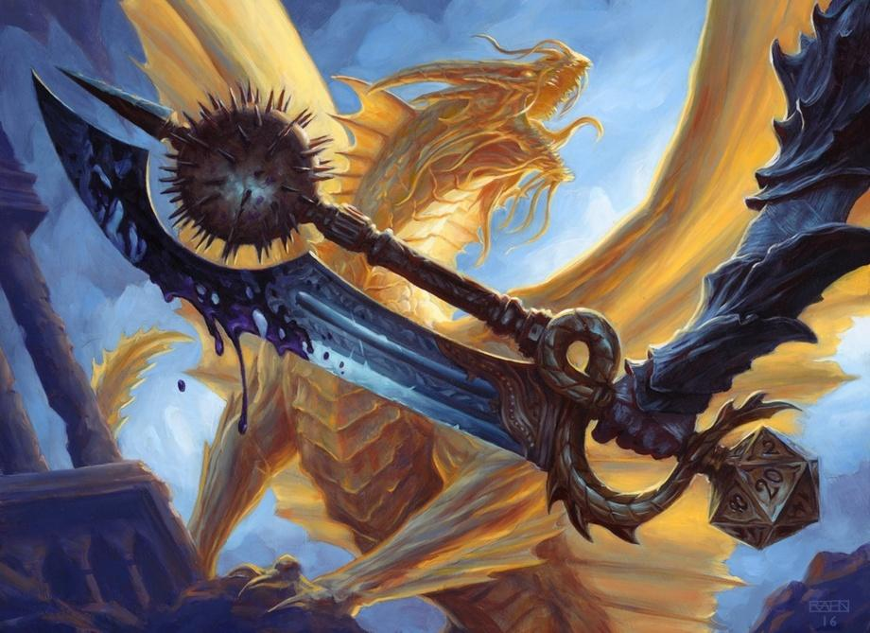
DUNGEON MASTER 2000
MARTIN HORVATH, ANDREA SCHWARZBAUER, MICHAELA TIMMERER-MAIER

Slide 2
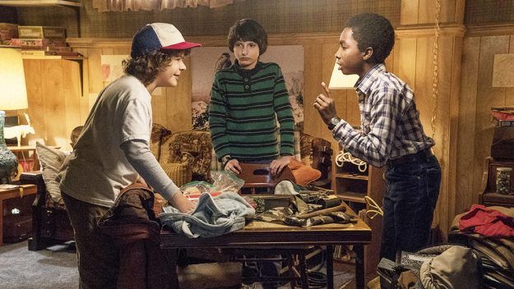
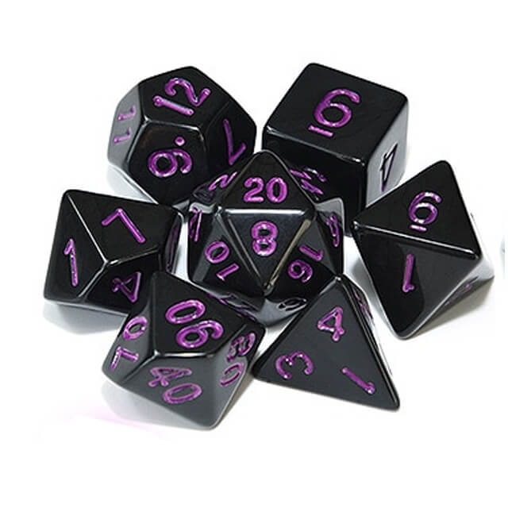
LET US INVITE YOU INTO THE WORLD OF D&D
Tabletop RPG
3 players min.
Dungeon Master

Slide 3
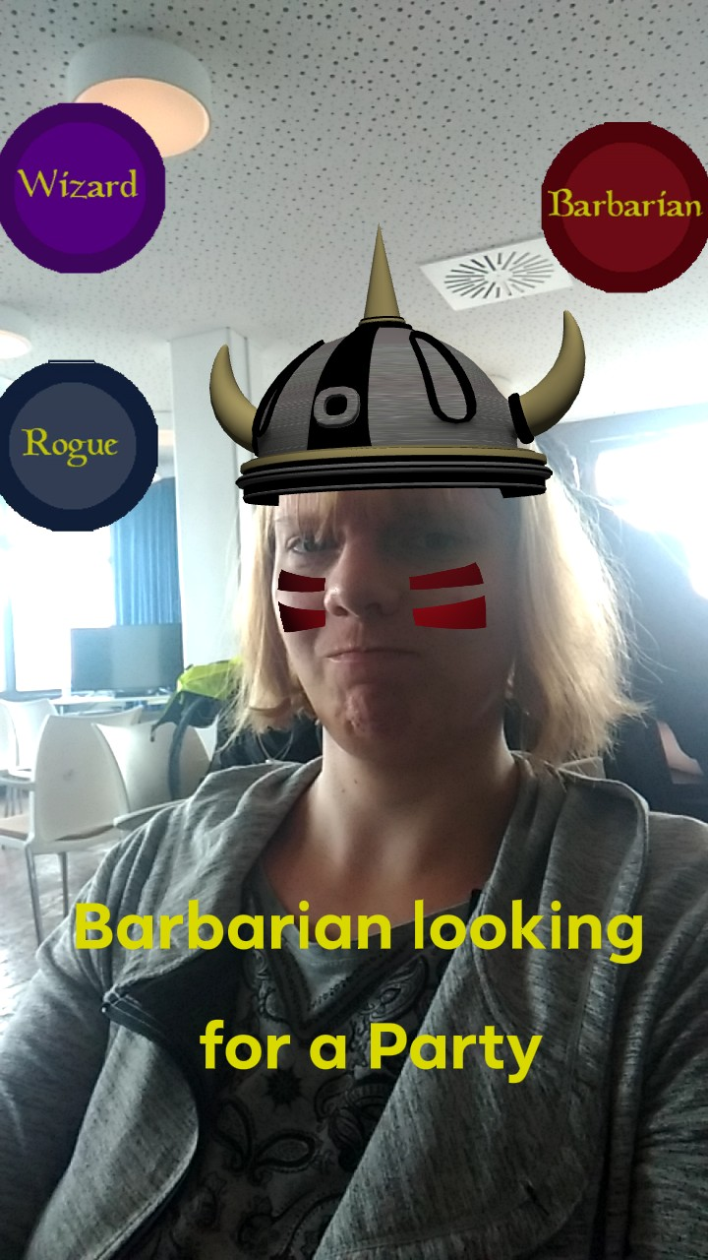
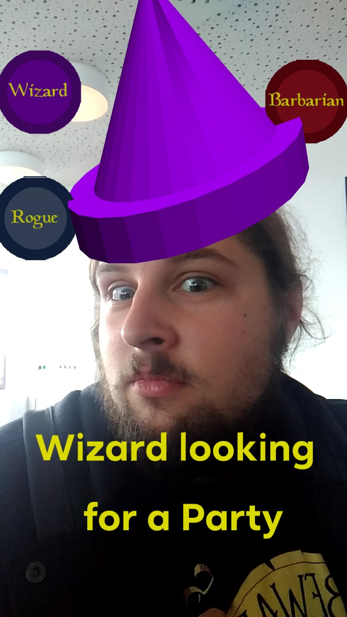
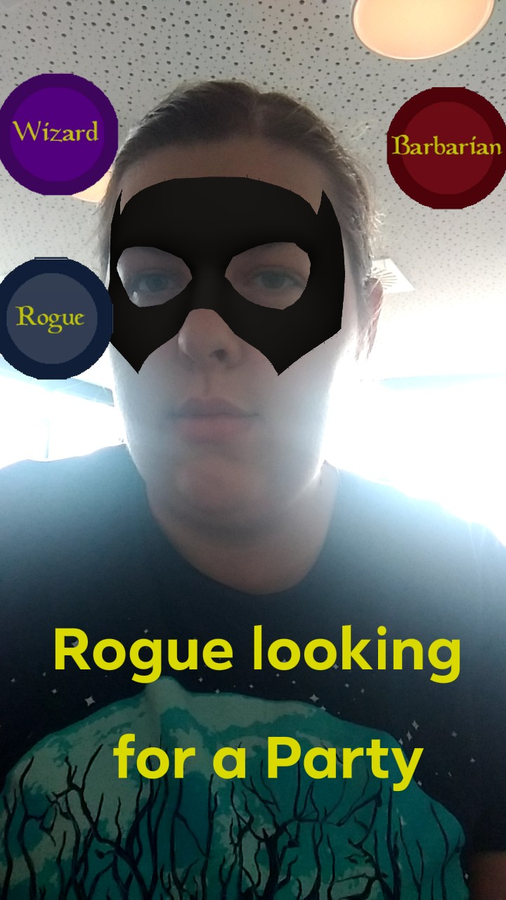
Alone and looking for a party?
Use our new Instagram Filter #LookingForDndParty

Slide 4
BUT WHAT TO DO IF YOU CAN’T FIND A PARTY?
MEET DUNGEON MASTER 2000

Slide 5
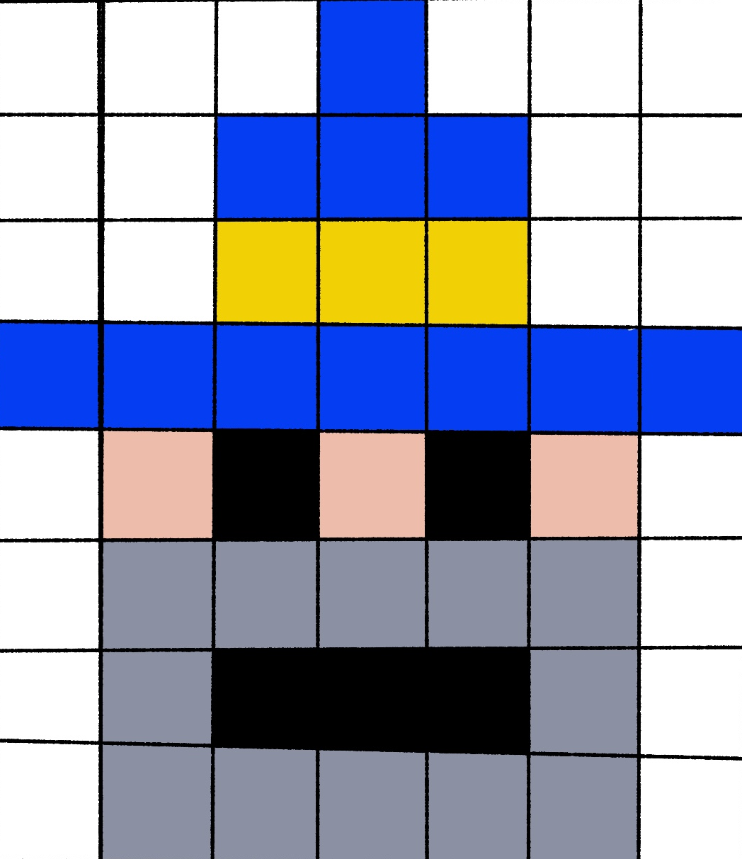
DUNGEON MASTER 2000
Single player
No friends needed
Visuals like it‘s 1972

Slide 6
BUT LISTEN TO WHAT HE HAS TO SAY!

Slide 7
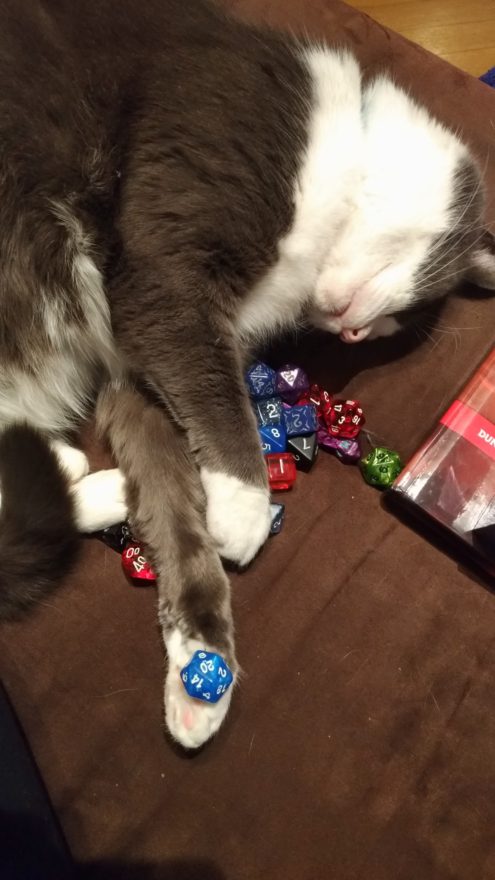
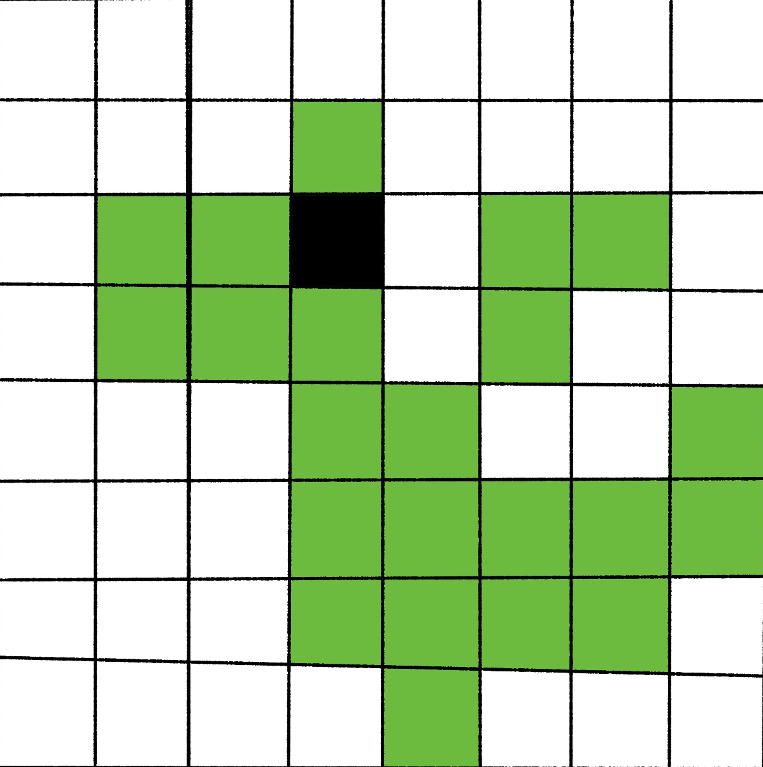
HAPPY DUNGEONEERING!!
AND MAY YOUR DICE BE BLESSED!
FROM THE THREE FLAMINGOS

